Slide 1

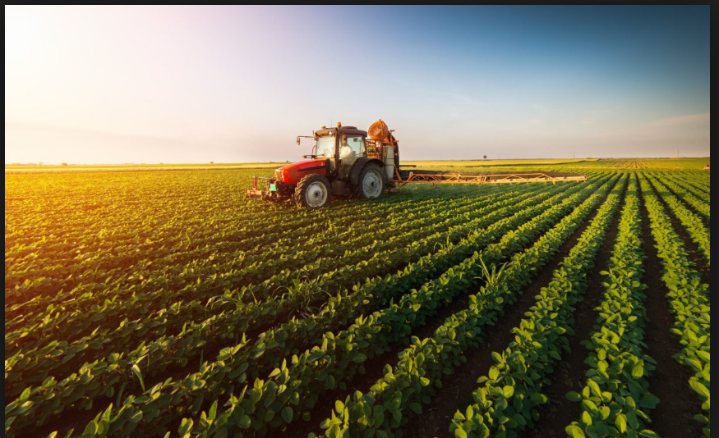
A PROJECT ON BEST CROP PREDICTION USING MACHIN LEARNING.
M.BHAVANA(16AK1A0509)
S.RAKESH(17AK1A0587)
L.LIKHITHA(17AK1A0551)
SK.REEMA(17AK1A0214)[EEE]
N.SOWMYA SREE(17AK1A04B5)[ECE]
DEPARTMENT OF COMPUTER SCIENCE AND ENGINEERING
ANNAMACHARYA INSTITUTE OF TECHNOLOGY AND SCIENCES,TIRUPATI.

Slide 2

OUTLINE OF PRESENTATION
INTRODUCTION
BEST CROP PREDICTION USING KNN
K-NEAREST NEIGHBOUR(KNN)
METHODOLOGY
CONCLUSION

Slide 3

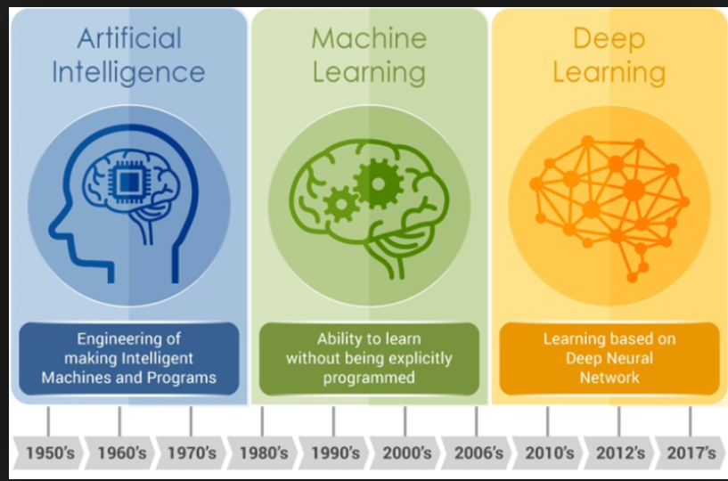

INTRODUCTION
Artificial intelligence in today's world is progressing rapidly with new advanced innovations day in day out. Today's computer systems are designed to perform small tasks, for instance, facial recognition, car driving, and performance of other minor duties. However, the primary goal of artificial intelligence is to develop advanced and more complex systems that would outperform humans at whatever way.

Slide 4
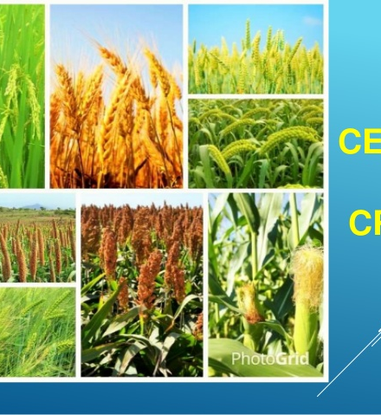
BEST CROP PREDICTION USING KNN
Crop prediction methodology is predict the suitable crop by sensing various parameter of soil and also parameter related to atmosphere(such as sunshine hours,rainfall,temperature).Hence these parameters are considered as the input for the proposed system and desired output must be produced.
Predictions could be used by crop managers to minimize losses when unfavourable conditions may occur.

Slide 5
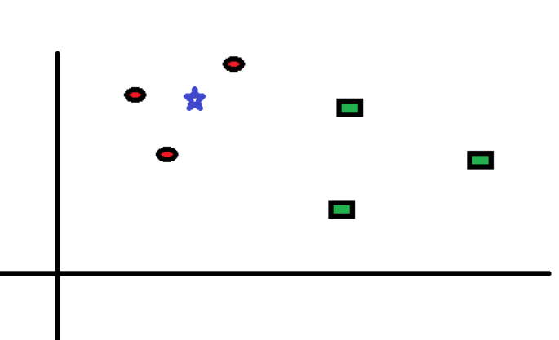
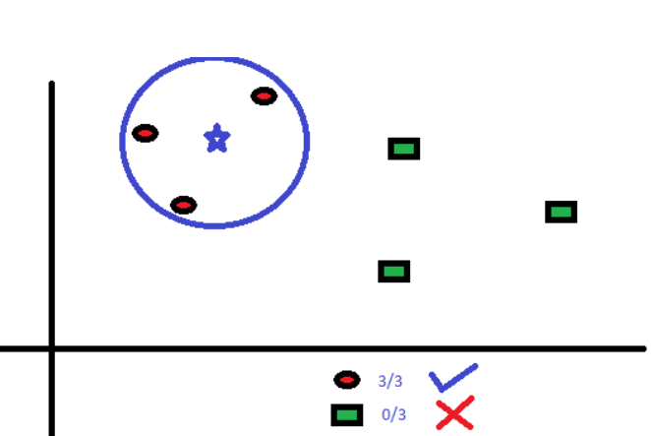
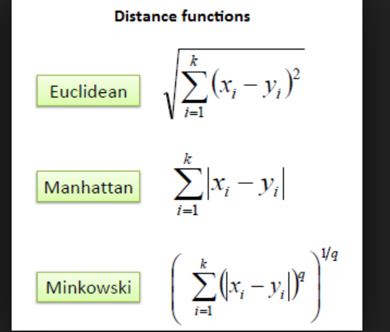
K-NEAREST NEIGHBOUR

Slide 6
METHODOLOGY
Import libraries and dataset in .csv format.
Divide the input and output values i.e(x&y)values.and use label encoders if necessary.
Split the test and train values from the data and import keras.
Fit the model with transformed trained values
Import the knn classifier and declare the neighnbours.
Construct the convoulution matrix and predict the accuracy.

Slide 7
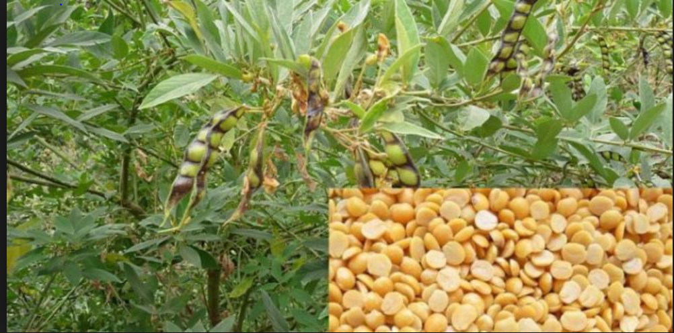
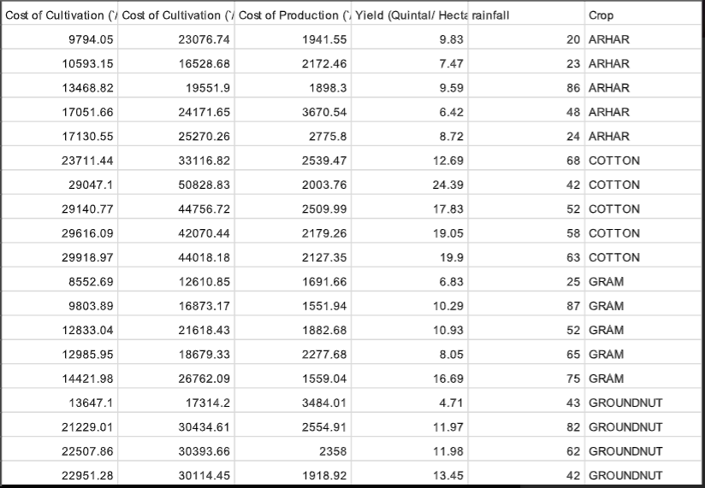
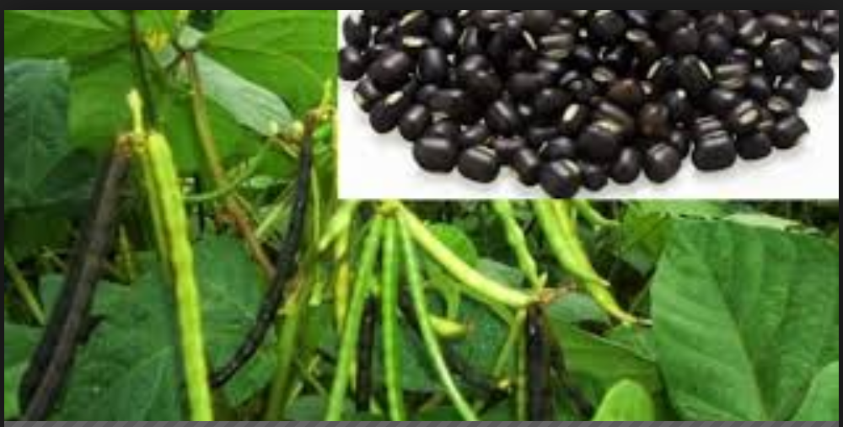
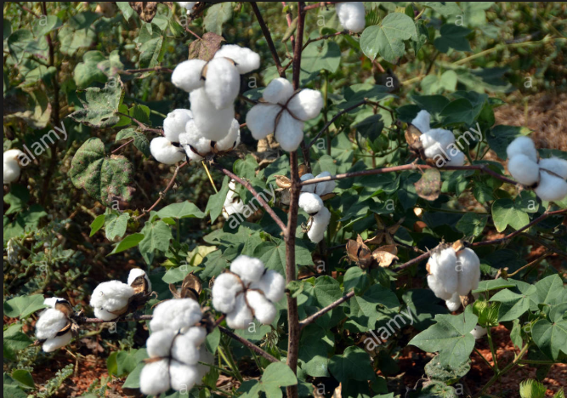
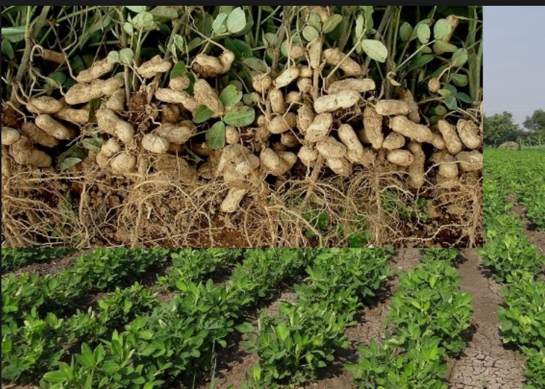
PREDICTING THE BEST CROP:-)

Slide 8

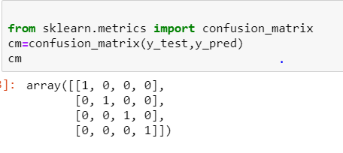
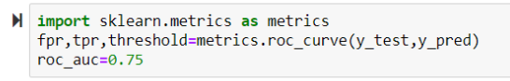
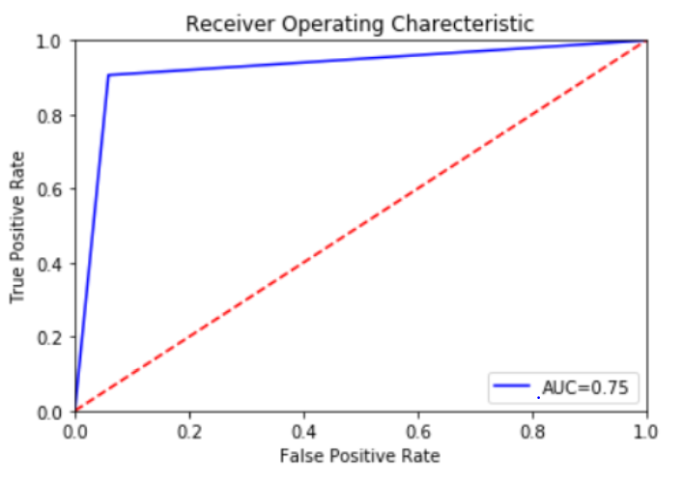

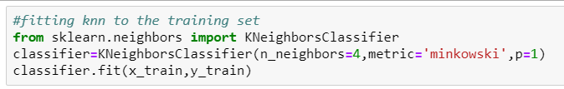
FINDING THE ACCURACY:

Slide 9
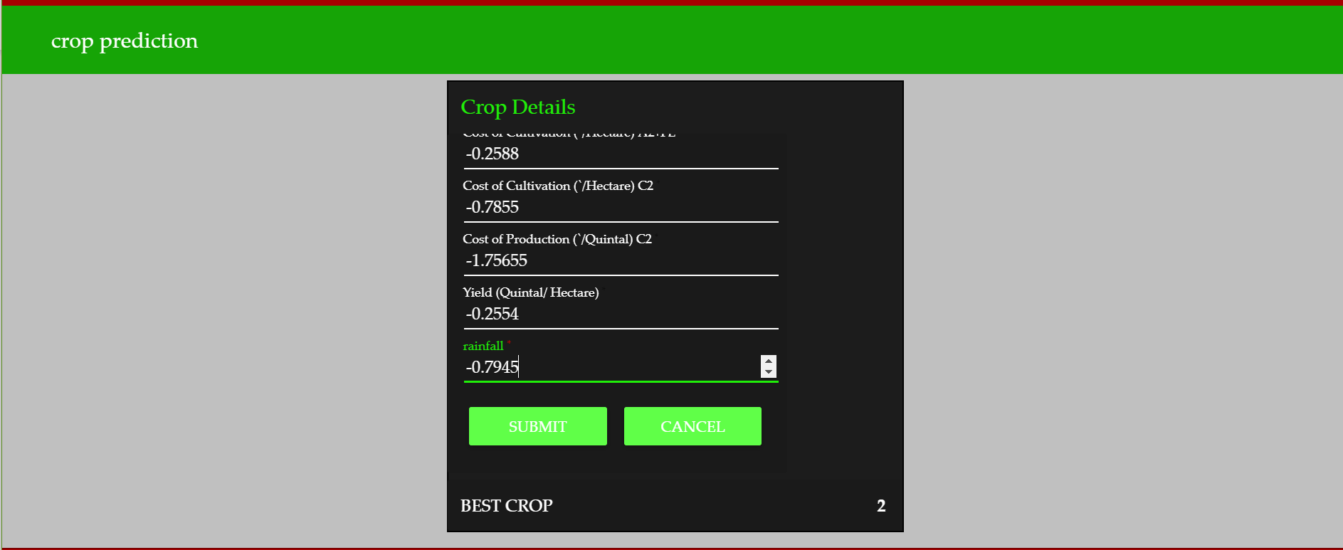

Slide 10

From the above results it is identified that proposed system functions properly on the input data manipulates it provides the desirable output.
Hence KNN is the beneficial tool for crop prediction.

Slide 11



Slide 12


ANY QUERIES

